Slide 1





HACK KRMU 5.0
Problem Statement ID :
PS7- Digital Doctor for Farmers
Team Name :
VISIONX
TEAM ID :
HK-054
TEAM MEMBERS :
Piyush Jain – 2501060053
Rishabh Bhardwaj – 2501060109
Harshit – 2501060005
Sneha Kumari – 2501060163
01

Slide 2

HACK KRMU 5.0
Problem & SOLUTION
Problem:
Farmers suffer major crop losses due to late and incorrect disease identification. Limited access to agricultural experts forces reliance on local pesticide sellers, leading to improper chemical usage, soil damage, and reduced productivity. Language barriers and lack of awareness further restrict access to accurate guidance.
Solution:
We built a AI-based crop doctor that helps farmers detect and treat crop diseases effectively.
Our solution:
Detects crop diseases using uploaded photos
Provides treatment guidance in local languages
Offers location-based recommendations
Generates a structured 7-day recovery plan
This system acts as a digital agricultural expert accessible anytime through a smartphone.
02

Slide 3
HACK KRMU 5.0
Flow of Solution
The solution follows a structured workflow:
Farmer opens the web application
Uploads image of diseased crop
System detects location and environment
AI analyzes image and identifies disease/pest
Weather and crop database are checked
Treatment and pesticide recommendations are generated
The farmer reCIVES:
Disease name
Recommended cure
Exact dosage instructions
A structured 7-day action plan
Voice and text guidance in the local language
This ensures clarity, accessibility, and practical execution.
03

Slide 4
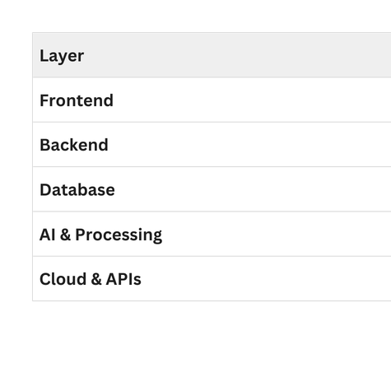
HACK KRMU 5.0
TECH STACK & APPROACH
Technology Stack:
Approach
We use a micro-service architecture to ensure scalability and performance:
React handles the user interface and dashboard.
Node.js manages API routing and request handling.
FastAPI (Python) processes AI-based disease detection and predictions.
PostgreSQL securely stores farmer data, crop history, and treatment records.
This modular structure allows independent scaling of AI services and backend operations.
04

Slide 5
HACK KRMU 5.0
UNIQUENESS & INNOVATION FACTOR
AgroGuard AI stands out due to the integration of multiple advanced features into one unified platform.
Key innovations include:
AI-based crop disease detection
Support for local Indian languages
Voice and text-based output
Location-specific treatment recommendations
Structured 7-day recovery action plan
Disease history tracking for farmers
Low-bandwidth optimization for rural areas
Unlike traditional agriculture apps that only provide general information, our solution delivers personalized, intelligent, and location-aware guidance.
05

Slide 6
HACK KRMU 5.0
Feasibility & Challenges
Feasibility:
The system is highly feasible due to the use of modern web technologies and scalable cloud infrastructure.
Built using widely adopted web technologies
Accessible through any smartphone browser
Cloud-based backend ensures scalability
PostgreSQL enables structured and secure data storage
Challenges
Internet connectivity in remote rural regions
Need for diverse and accurate training datasets
Farmer awareness and technology adoption
These challenges can be addressed through offline optimization, dataset expansion, and farmer training initiatives.
06

Slide 7
HACK KRMU 5.0
Research & Reference
The development of AgroGuard AI is supported by research and publicly available datasets:
Government Crop Disease Dataset
Kaggle Plant Disease Dataset
FAO Agriculture Reports
Indian Meteorological Department
OpenWeather API
Research papers on Plant Disease Detection
These references ensure that our solution is scientifically grounded and practically viable.
07

